Slide 1
Unit Test
Principles, Practices and Patterns

Slide 2
Index
Unit Test Principles (What, Who, Why)
Definitions
Characteristics
Test is not a unit
Unit Test benefits
Effective Unit Test
Ineffective Unit Test
Types of tests
Test Pyramid
Integration Test

Slide 3
Index
Unit Test Practices (Where, When, How)
Four phases of Automated Test
Unit Test Tools
Unit Test Project Hierarchy
Unit Test Structure
Naming a unit test
Parameterized Tests
Using an assertion library to further improve test readability
Isolation Unit Test with Test Doubles
Mocking best practices

Slide 4
Index
Unit Test Practices (Where, When, How)
Good Unit Test
Unit Test Best Practices

Slide 5
Index
Unit Test Patterns (Master of Unit Test. To be continues)
xUnit Patterns (http://xunitpatterns.com/)
Test-Drivent Development (TDD)

Slide 6
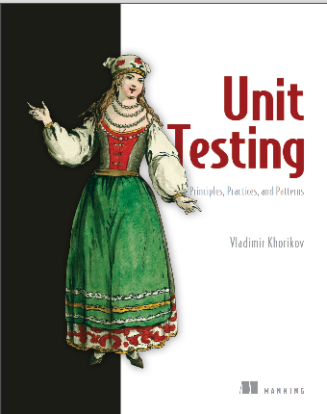
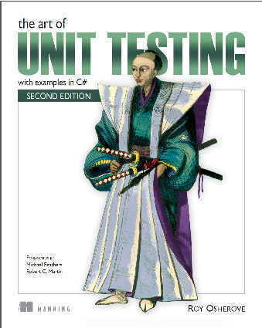
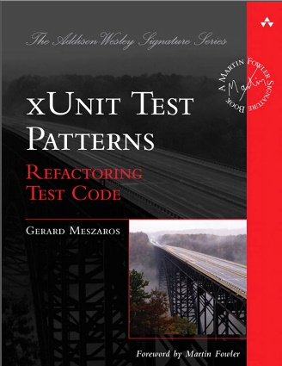

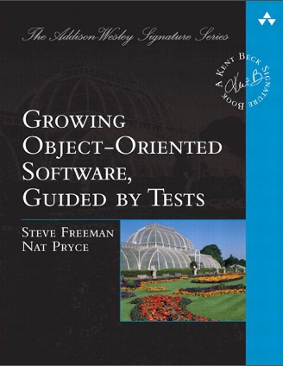

References

